Slide 1

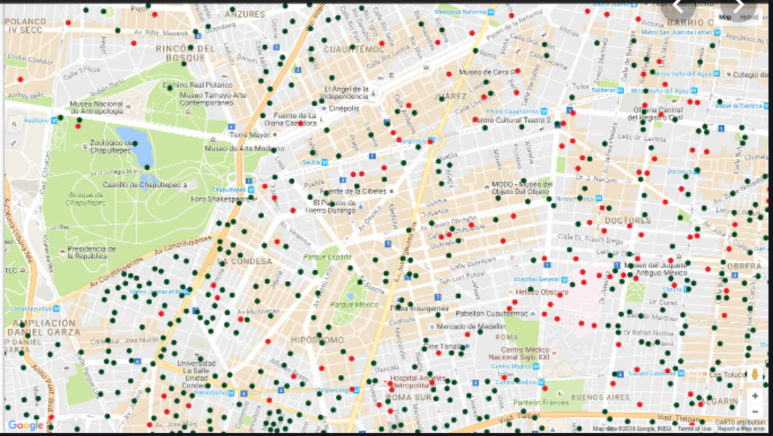


Crime Scene CDMX
Los Json´s
Notes:
© Copyright Showeet.com

Slide 2
AGENDA
01
Introduction
1’
02
Objectives
1’
03
Key Points
1’
04
Results
4’
05
Plots
4’
06
Conclusion
4’
Notes:
© Copyright Showeet.com

Slide 3
Introduction
Crime Scene CDMX
Carpetas de Investigación PGJ CDMX
01
02
Information Analysis
Recategorize Crime Variables
03
04
Create a Solution

Slide 4
Objectives
Crime Scene CDMX
01
02
03
Database Analysis
Find crime relation
Deep Crime learning
Analysis Crime data from CDMX to find the number of crime reports 2016-2019.
Create a DataFrame to find a relationship between types of crimes., place and frequency.
Find an Algorythm that can predict relationships between crimes .
04
05
Crime Forecast
Create API Live Map
Predict critical events through data.
Create a live map that can help the users to have a better perspective of crime in their neighborhoods.

Slide 5
Hypothesis
Crime Scene CDMX
“Determine the difference crime rate, between Districts to identify the most recurring crimes in each one and analyze the crime behaviour by year.”
What are the highest crime rate Districts?
What are the mos recurring cimes in each District?
How does each crime behave through the years?

Slide 6
KeyPoints
Crime Scene CDMX
Data Analysis
Recategorize
Explore the actual data from “CDMX Datos Libres”, to find the main report crimes.
Find new categories to classified crimes, to be able to build DataFrames.
01
02
Documentation Analysis
Plot Results
Analysis documentation of the JSON Api and the CSV files of the database.
06
03
Plot the main results with the new categories, districts and top 10 crime events.
Keywords
05
04
Find the main keywords of Crime events and build dictionaries.
Program Structure
Structure a program that will give us a deep analyiis of crime behavior through districts.

Slide 7
Results
Crime Scene CDMX
Theft
Family Crimes
Passerby Theft
Economic Crime
Vehicule Theft
Passenger Theft

Slide 8
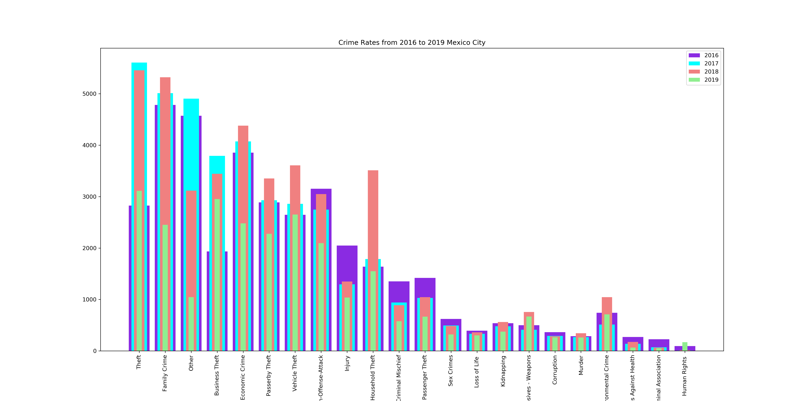
Plots
Crime Rates From 2016-2019

Slide 9
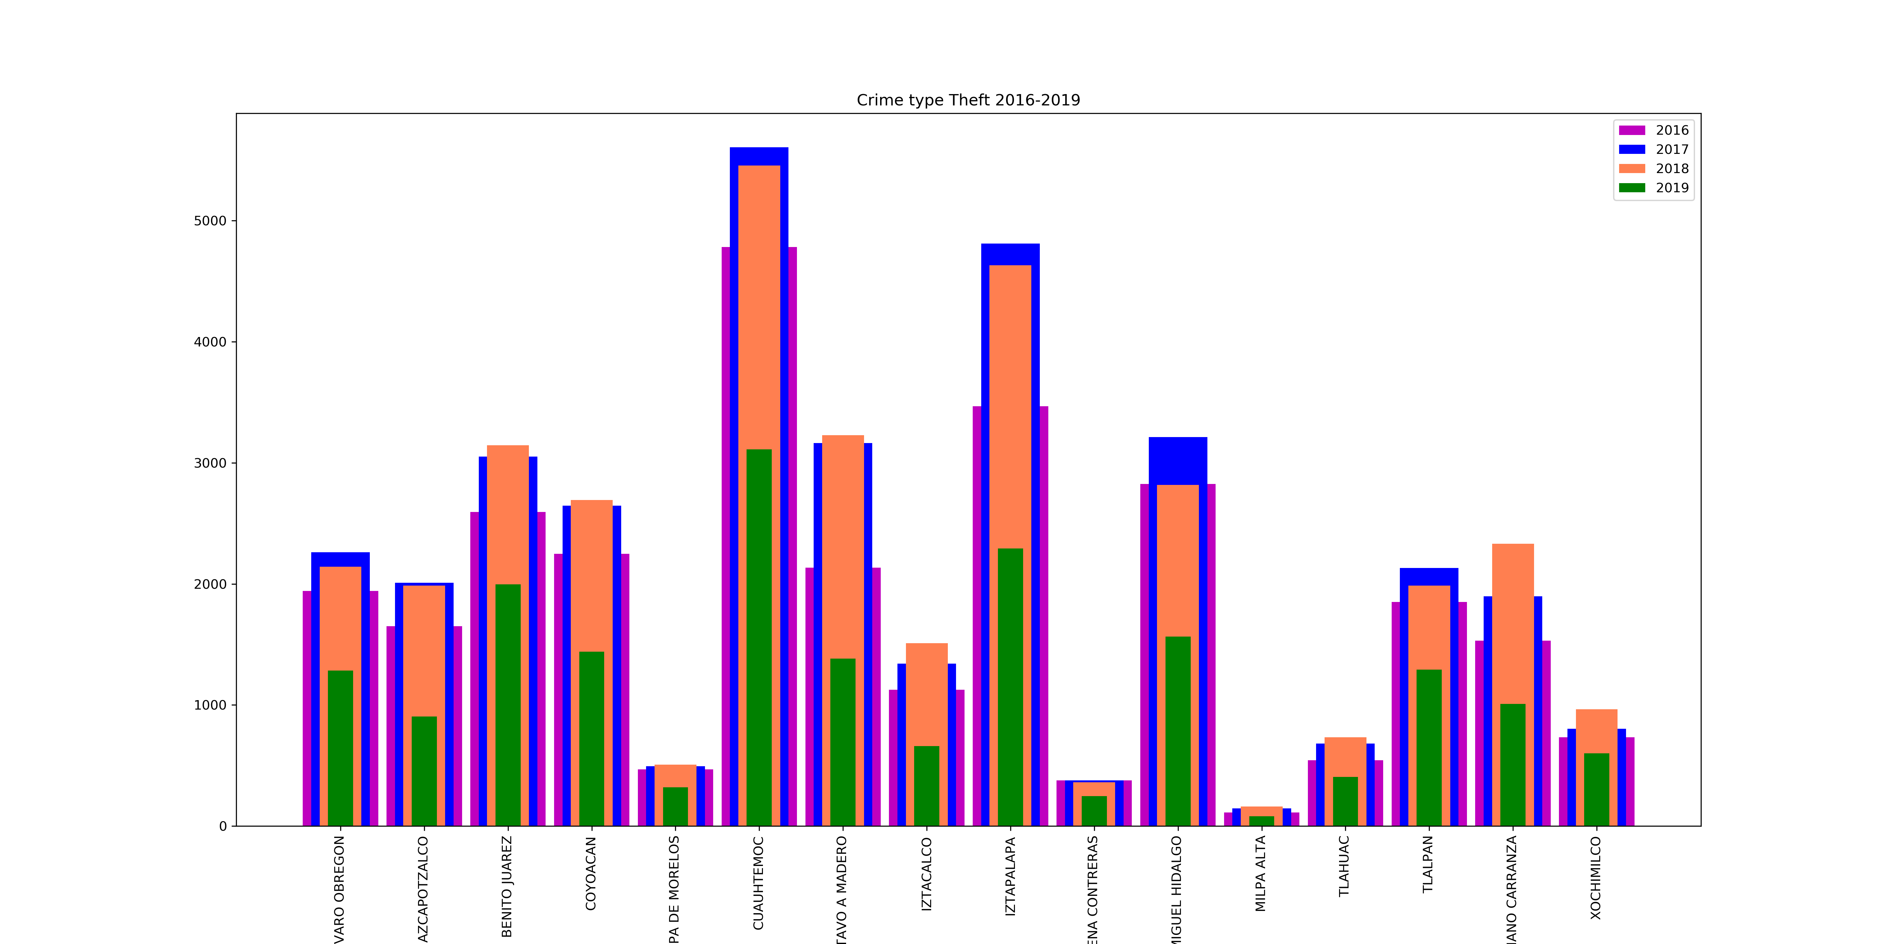
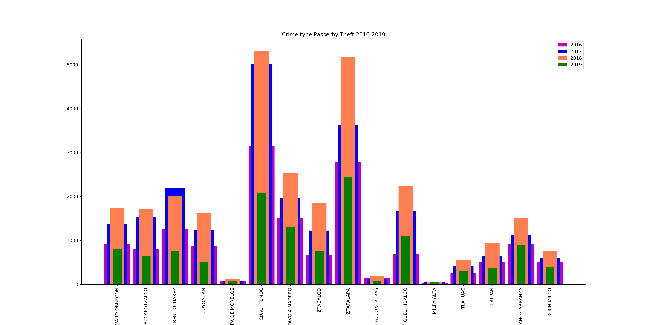
Plots
Crime Type Per Year

Slide 10
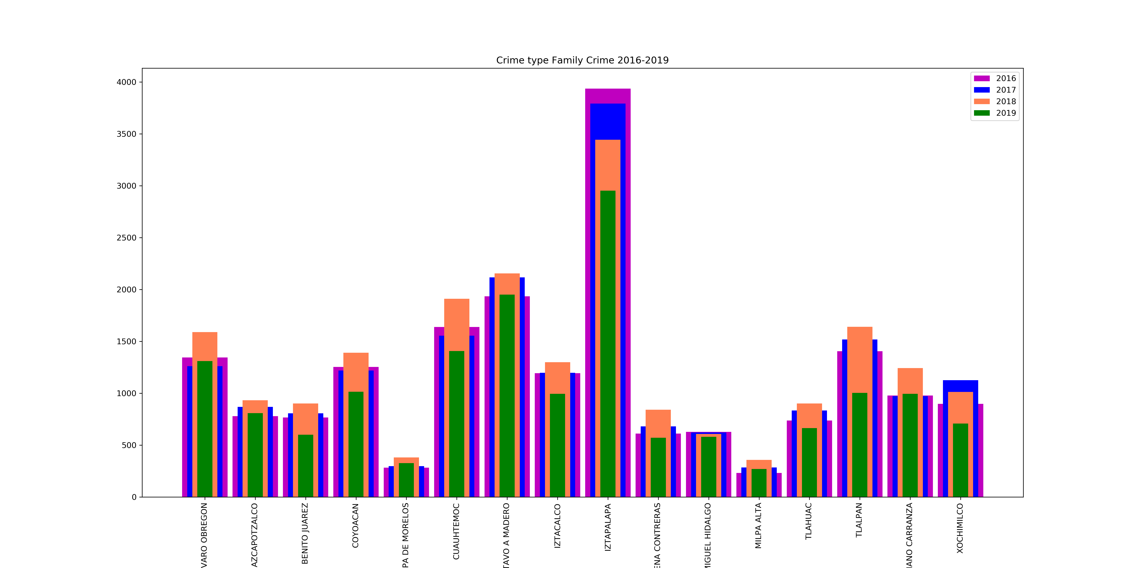
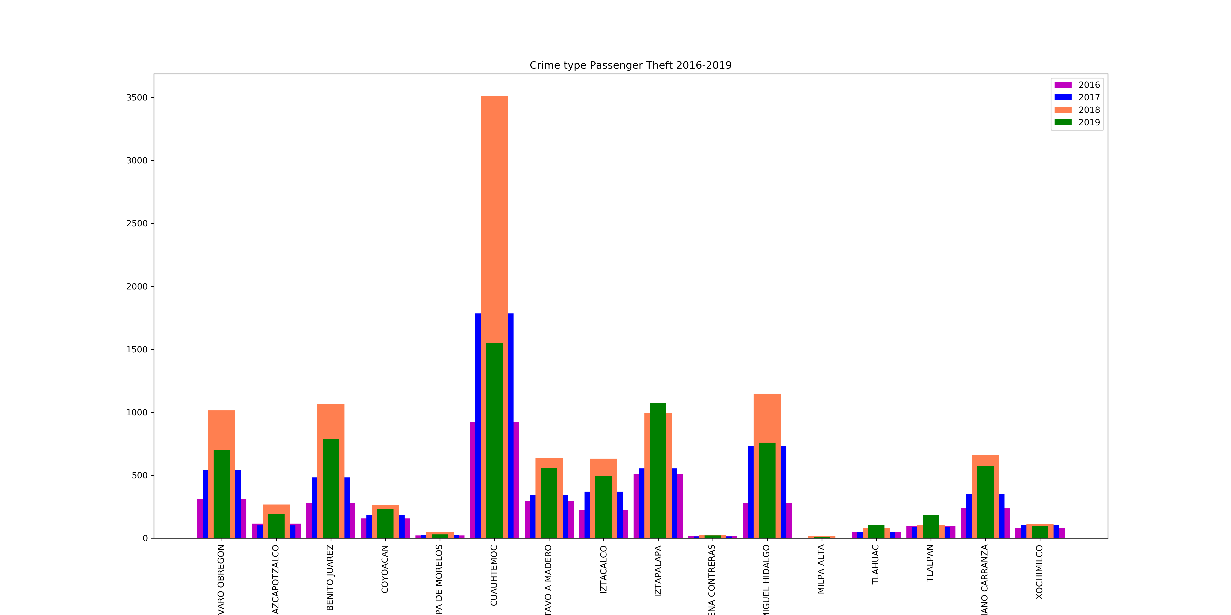
Plots
Crime Type Per Year

Slide 11
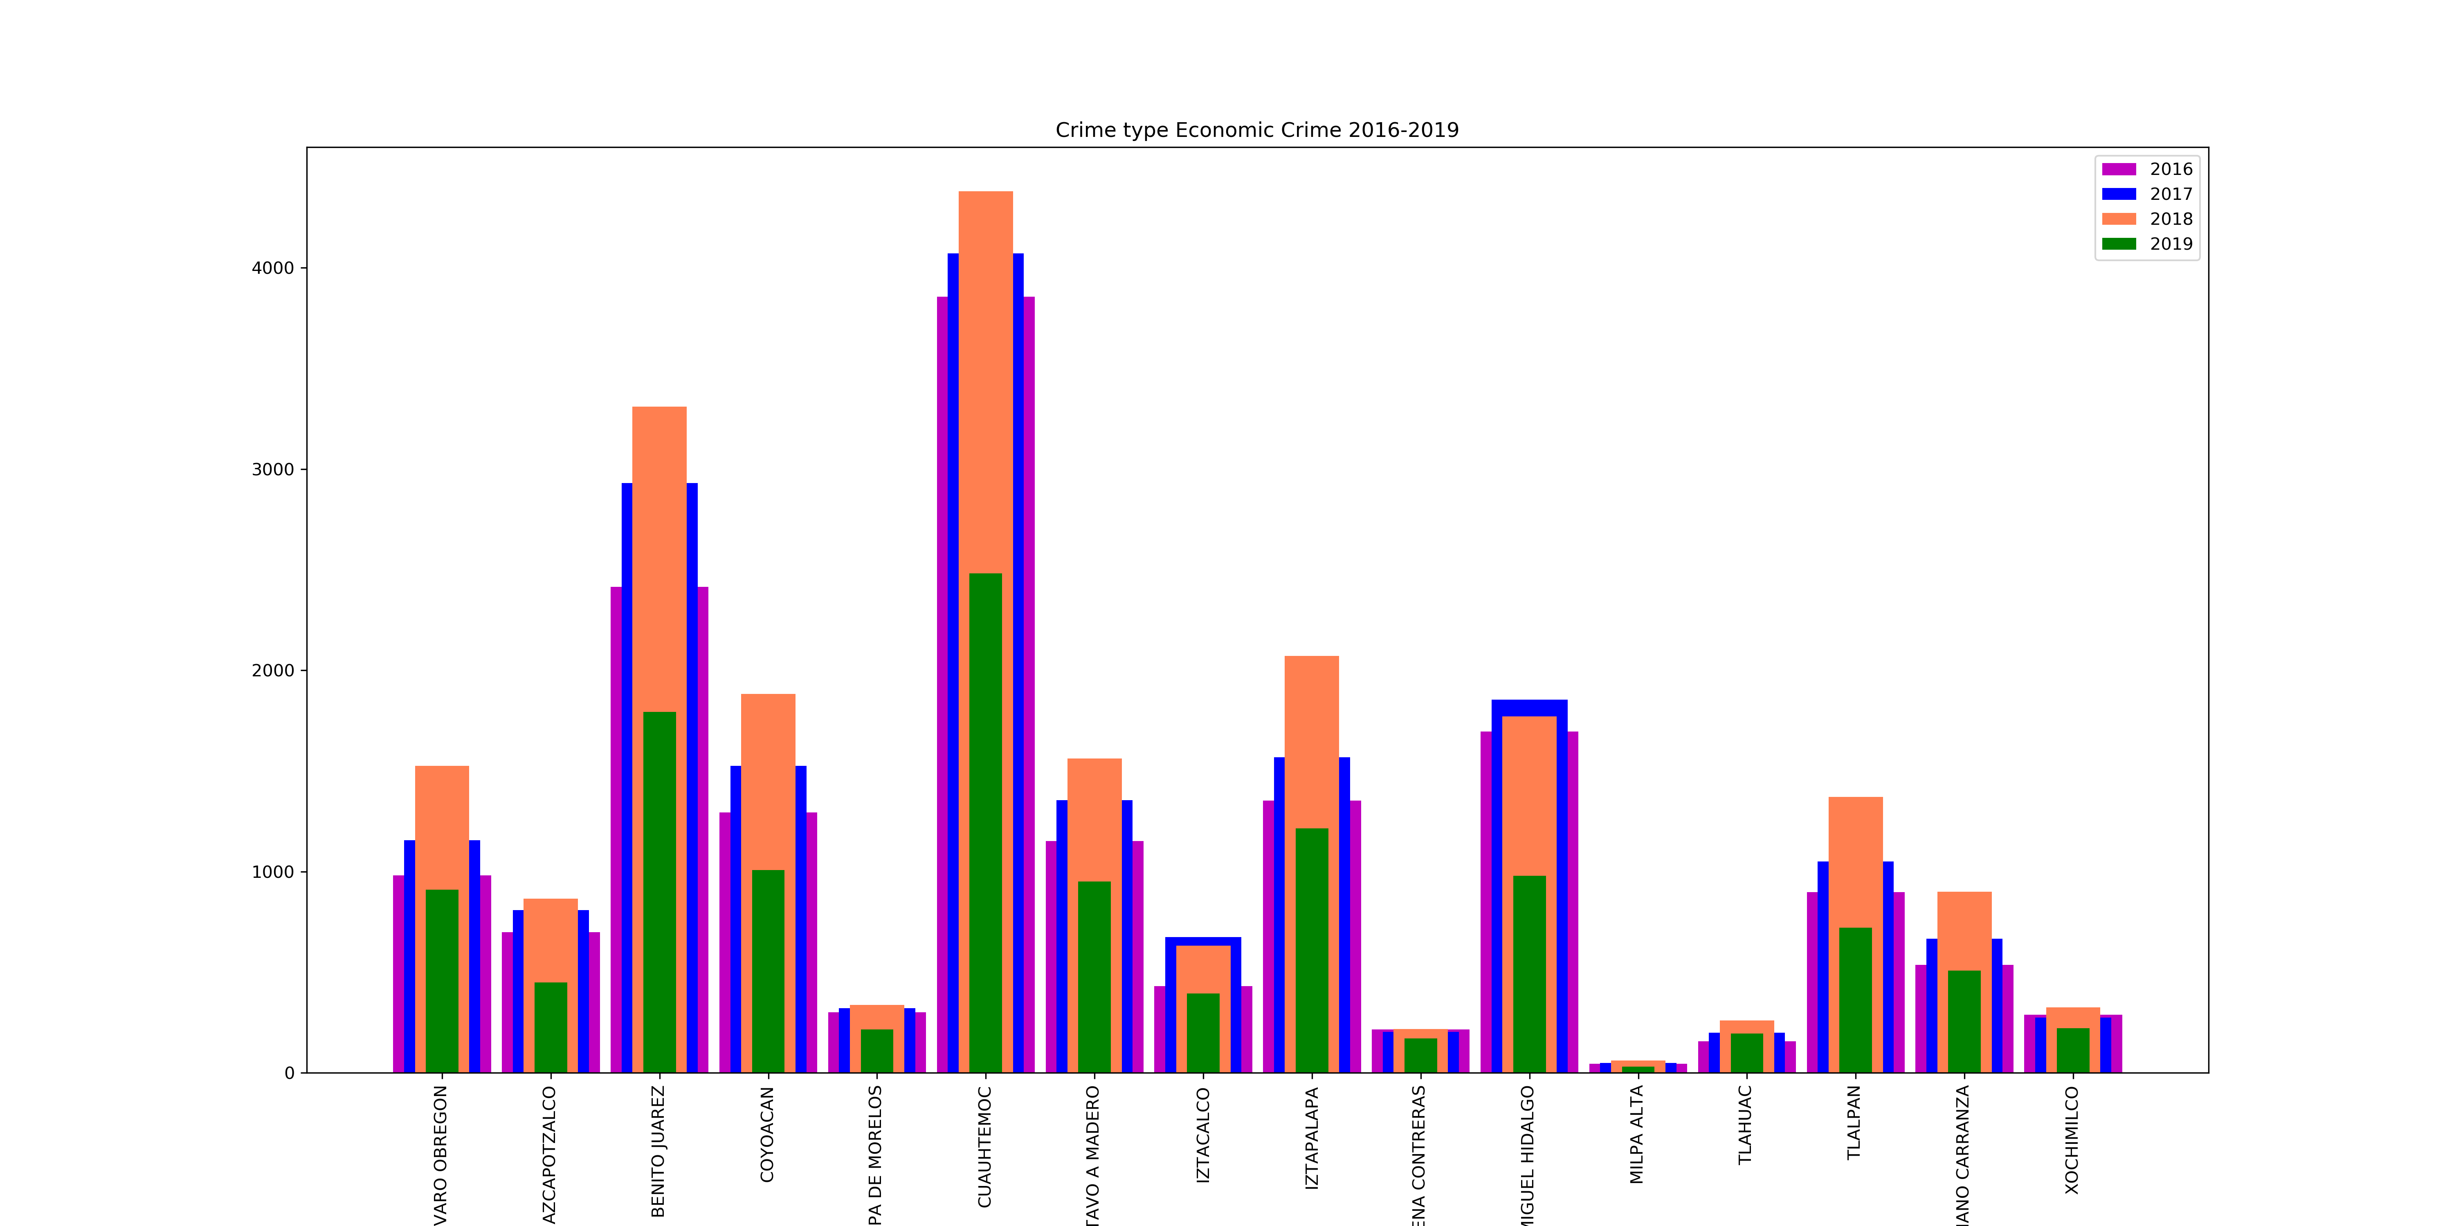
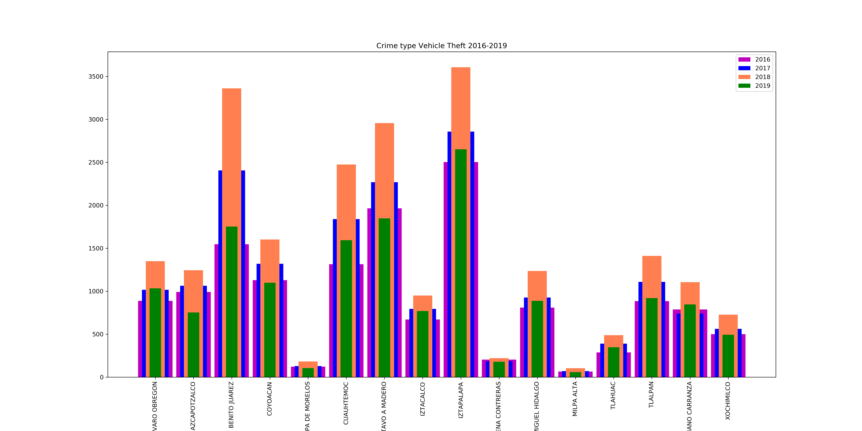
Plots
Crime Per Year

Slide 12
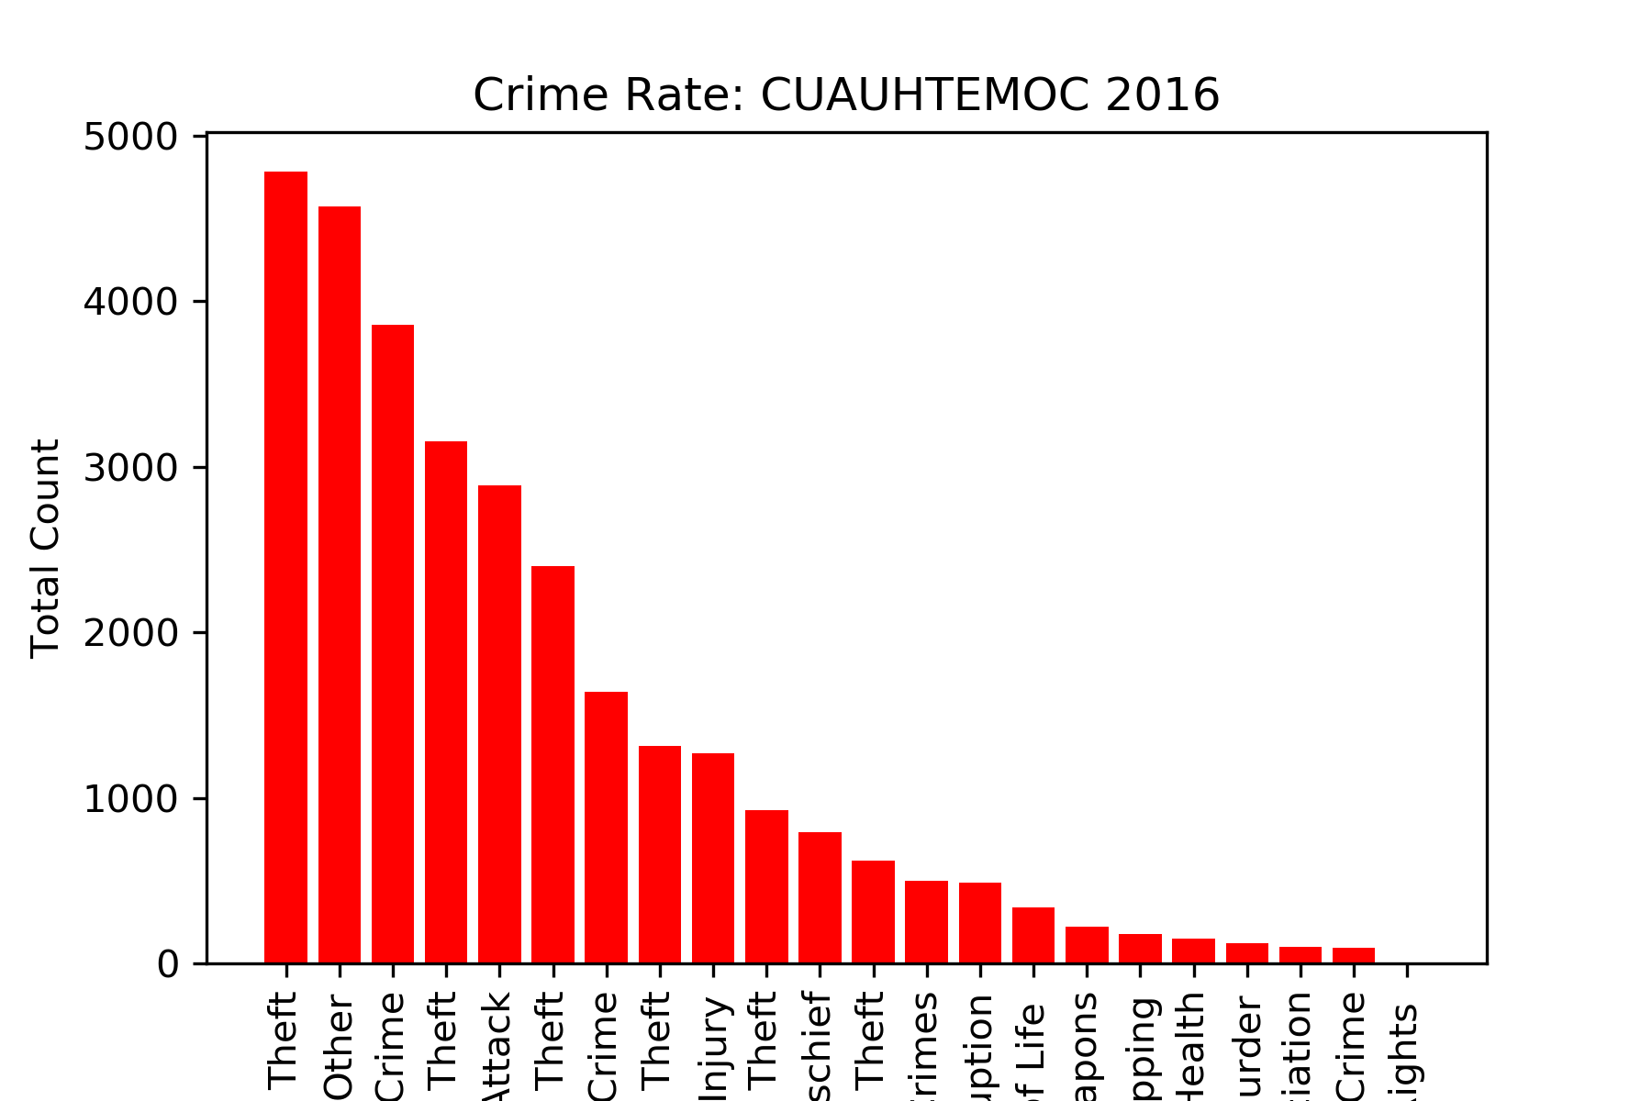
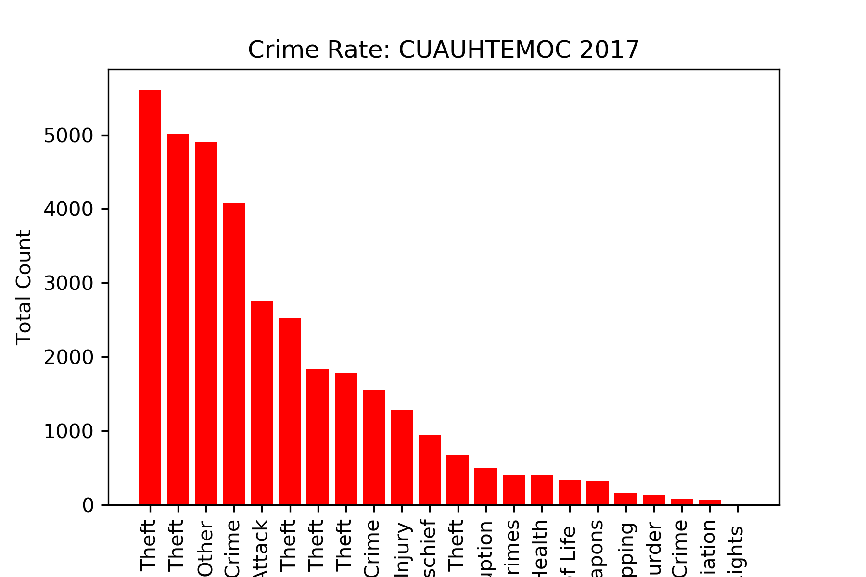
Plots
Crime Per District

Slide 13
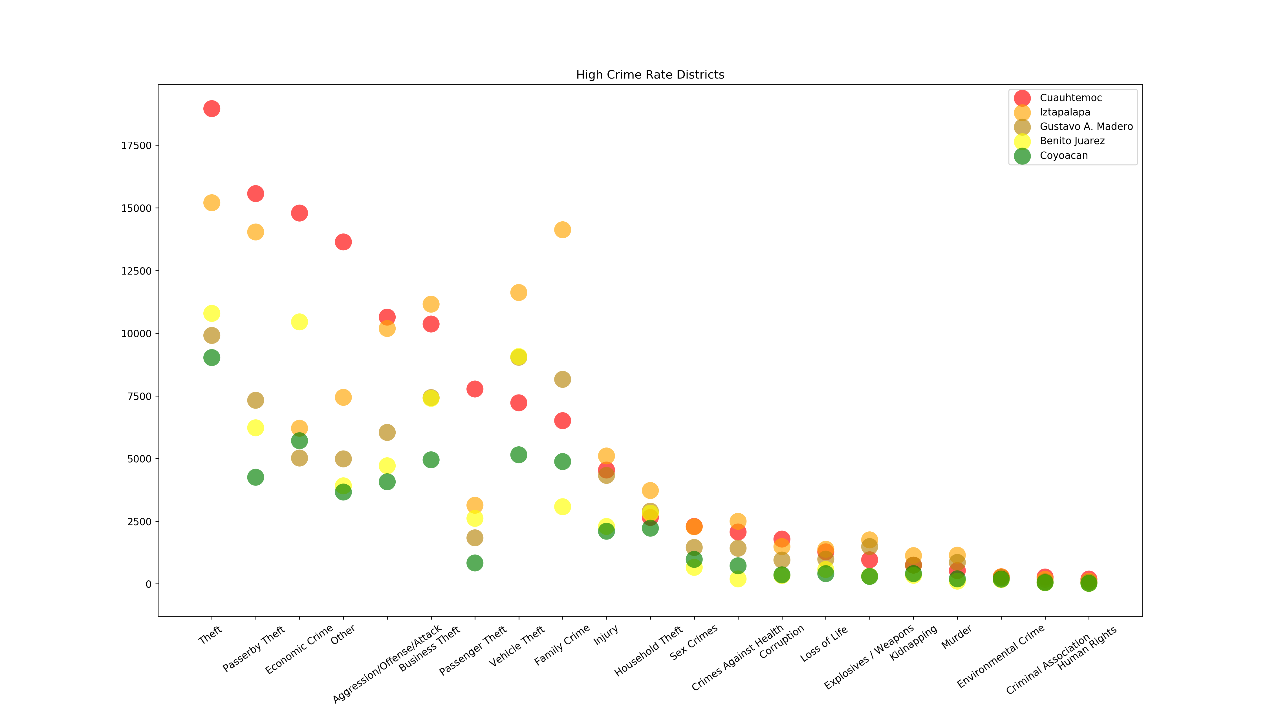
Plots
High Crime Rate Per District

Slide 14
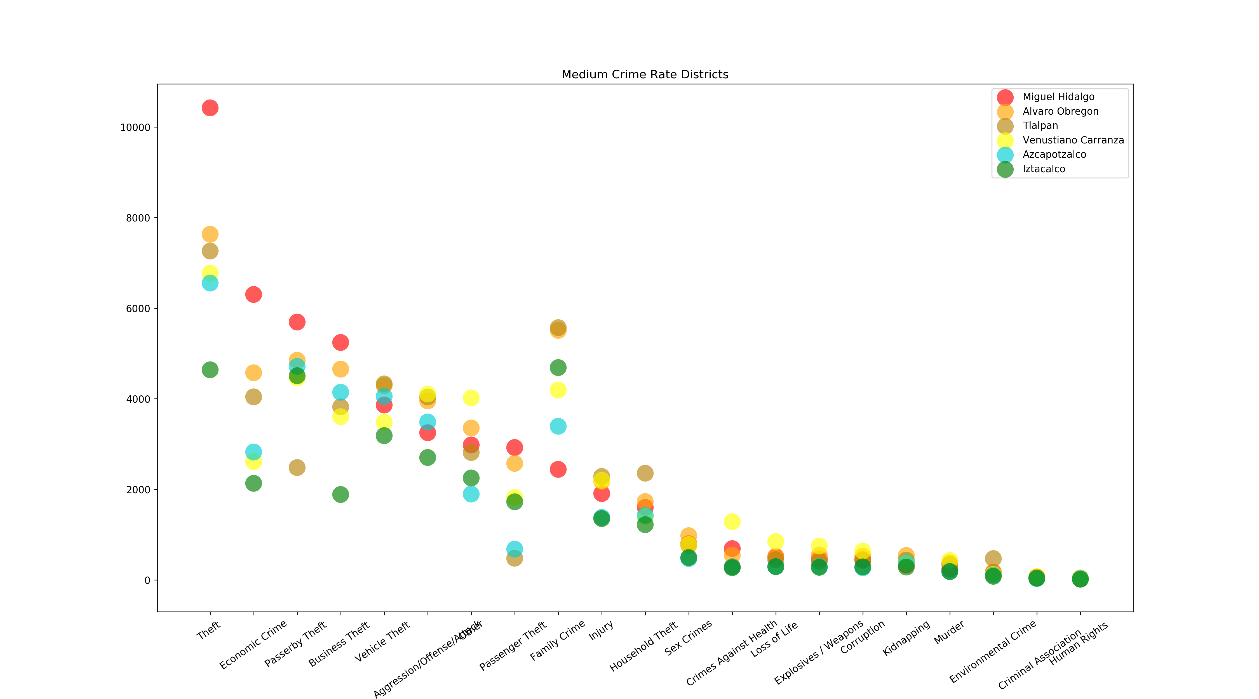
Plots
Medium Crime Rate Per District

Slide 15
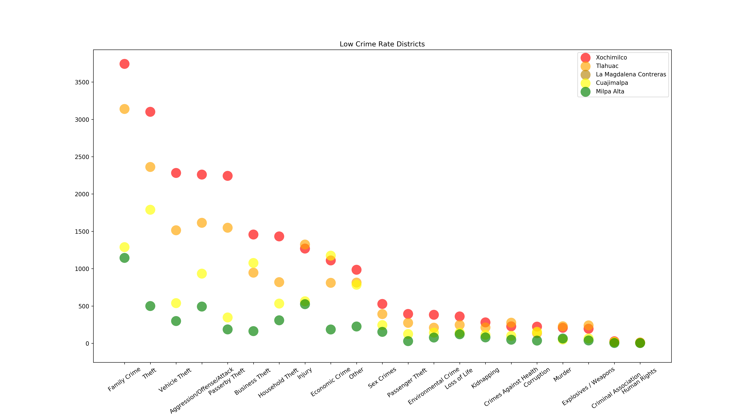
Plots
Low Crime Rate Per District

Slide 16
Conclusions
Crime Scene CDMX
Crimes tendency
Most Common Crime
01
02
In all districts theft is the most common crime, meaning that the likelihood of this crime to be committed is greater than every other crime
The crime tendency is increasing if we compare the results with previous years
Lower Crime Rate Districts
04
Data Accuracy
03
It was a surprise to us to see the quartile of Districts with lower crime rate. Keep in mind that data shows only criminal complain filings
It is important to have a culture of filing criminal complain so that in the future the accuracy of the data can increase

